Slide 1
Release Notes
Release 4.000.04
June 1, 2016

Slide 2
Table of Contents
Enhancement Slide #
Adding Territories to location 3
Territory Labels 4
Info Windows 6
Order Locations 7
Order Profiles 8
Results icons 9

Slide 3
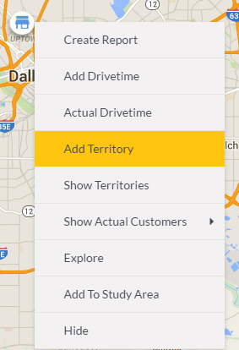
Adding Territories to locations
Description
Allows clients to add territories (either free drawn or selected from geographies) to be added to pushpins or stores.
How to use
Right click a pushpin or store, select Add Territory.
From there, either free draw a territory, or choose existing geographies (like a zip code as an example).
Value
Allows clients to give locations more context by attaching related items.

Slide 4
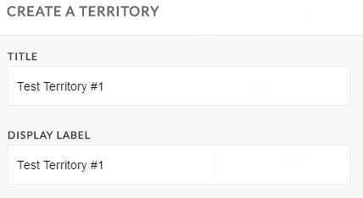

Territory Labels
Description
Clients can now name give territories a display label and value.
How To Use
When adding a territory, populate the field for Display Label.
Go to more options and populate Data Value.

Slide 5
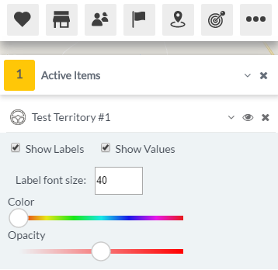
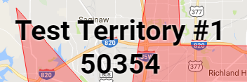
Territory Labels
Value
Clients can now easily see and present their territory data on the map.

Slide 6
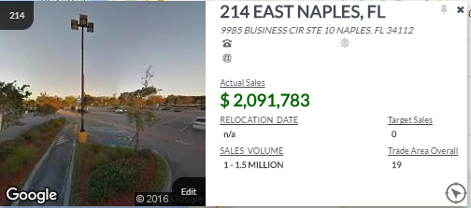
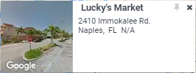
Info Window Changes - Before
Before
Description
Info windows have been given a face lift and functionality increase that will allow us to display more information while maintaining a readable info window.

Slide 7
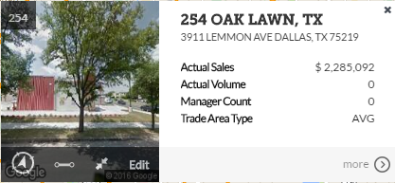


Info Window Changes - After
Description
On the left side with the street view image, the bottom bar has been added that contains the major functionality for the new info windows.
How To Use
(from left to right)
Explore – launches the explore window for that point
Pin – pins the ‘tail’ of the info window that points to the point from which it came
Expand / Collapse – changes between large and small info windows as desired
Edit – launches the dialog to change the data that the info window displays
Value
Allows for a more readable and more customizable info window

Slide 8
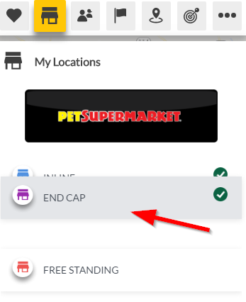
Order Locations
Description
Clients can now determine the order in which they see their locations.
How To Use
Under the Data Bar, select Stores, then drag and drop your locations to the order you desire.
In the screenshot, I’m moving the “End Cap” store to be at the top.
Value
Allows clients to order locations according to their desires.

Slide 9
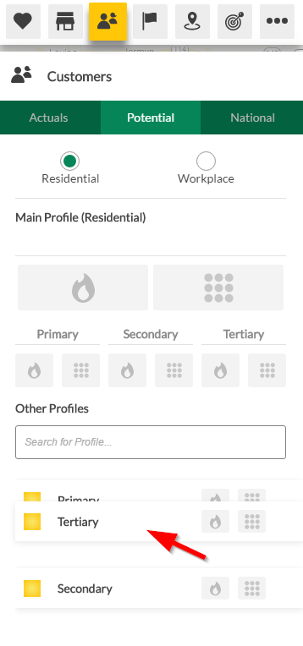
Order Profiles - Potential
Description
Clients can now determine the order in which they see their Potential profiles.
How To Use
Under the Data Bar, select Customers, then drag and drop your profiles to the order you desire.
In the screenshot, I’m moving the “Tertiary” profile to be at the top.
Value
Allows clients to order profiles according to their desires.

Slide 10
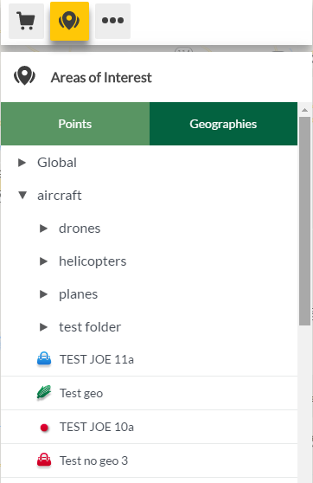
Results / Areas of Interest Icons
Description
Icons for Results and Areas of Interest are now more varied than on initial launch.

Slide 11
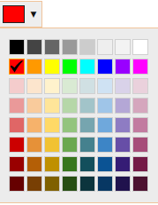
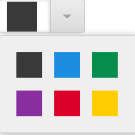
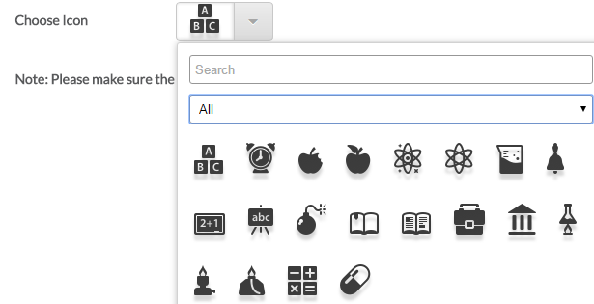
Results / Areas of Interest Icons
Results
(geography)
How To Use
When importing data through My Data, choices of icons are now presented to the client to choose.
Choose a color
Choose an icon
Value
Allows clients to order profiles according to their desires.
Areas of Interest (point)
Areas of Interest (point)

